Slide 1
Dominion Energy IRP Technical Conference April 25, 2019

Slide 2
2019 IRP Schedule
February 20, 2019 – Technical Conference
IRP Standards and Guidelines
Review of 2018 Order
Proposed 2019 IRP Outline
Renewable Natural Gas Update
Wexpro Well Freeze-offs
April 2, 2019 – Technical Conference
Heating Season Review
Long Term Planning
Normal Heating Degree Days Update
Rural Expansion
Rate Case Preview

Slide 3
2019 IRP Schedule
April 25, 2019 – Technical Conference
RFP Recommendations (Confidential)
Supply Reliability Results (Confidential)
May 29, 2019 – Technical Conference
Wexpro Matters (Confidential)
Integrity Management Update
June 20, 2019 – Technical Conference
Presentation of Integrated Resource Plan

Slide 4
Gas Supply RFP Recommendations

Slide 5
RFP Responses

Slide 6
Baseload Supply (Dth)

Slide 7
DEQP Peaking Supply (Dth)

Slide 8
Kern River Peaking Supply (Dth)

Slide 9
Total Supply Under Contract and Recommended 2019-2020 (Dth)

Slide 10
Supply Reliability

Slide 11
Supply Reliability RFP Evaluation
Backdrop
2018 Pre-Approval Application & Order
Supply Reliability Resource
2019 RFP Resource Requirements
RFP Response Summary
Serving Unserved Rural Communities

Slide 12
2018 On-System LNG Facility Docket (18-057-03)
Pre-Approval Application
On April 30th, 2018 DEU applied to the Utah Public Service Commission (PSC) for pre-approval of its on-system LNG Facility
As part of this Application, DEU compared the costs and benefits of the on-system LNG facility with 10 other options
There were four interveners to the docket: Division of Public Utilities (DPU), the Office of Consumer Services, Utah Association of Energy Users and Magnum LLC
On October 22nd, 2018 the Utah PSC denied DEU’s Application stating:
“As explained by witnesses from both the DPU and Magnum, DEU could have followed standard industry practice by issuing a well-defined RFP to identify the market options available to mitigate the specific risk DEU seeks to address…”
“We find that if DEU had solicited bids for a resource that could provide instantaneously 150,000 Dth/day of gas for eight days to DEU’s distribution system, i.e. the resource requirement specified in the Application, DEU would have a more complete record on which we could consider whether its selected reliability resource is in the public interest.”
“We conclude that the ability of the LNG Facility to serve, remote, currently unserved locations could qualify as a relevant factor under our required analysis, but we find the record in this proceeding is insufficient to consider that factor”

Slide 13
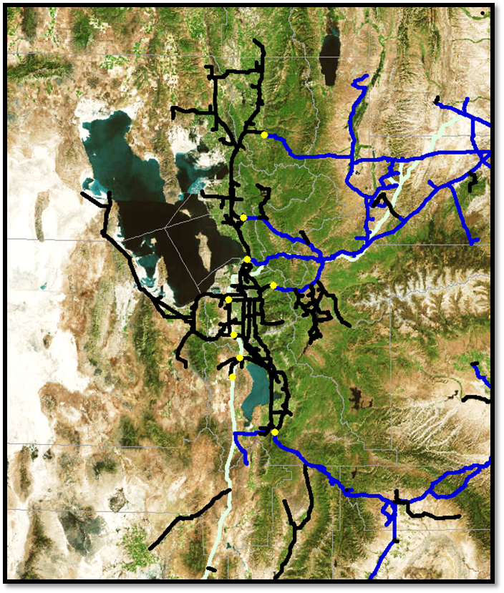
2019 Dominion Energy Utah RFP
Supply Reliability Resource
On January 2nd, 2019 DEU issued a supply reliability RFP seeking proposals for a resource that provides natural gas supply to the DEU system in the event of supply disruptions. The resource must provide:
Optimal delivery of up to 150,000 Dth/day
Optimal delivery pressure of 650-720 psig
Total Annual Supply of 750,000-1,500,000 Dth
Delivery of Supply must be available on an as-needed basis no later than 30 mins from call
Gas supply must be continuously available to utilize the total annual supply
The RFP provided that all submitted proposals would be evaluated
against DEU’s on-system LNG facility as described in Docket 18-057-03
DEU specified an optimal area for supplies to be delivered into the Demand Center
For responses with proposed delivery outside the optimal area, additional costs for DEU system reinforcements that may be needed to achieve equivalent system impacts
would be added to the total proposal cost
RFP Responses were due on March 4th, 2019
DEU received RFP responses from three entities, Magnum LLC, Prometheus Inc.,
and United Energy Partners
471 psig
354 psig

Slide 14
2019 Dominion Energy Utah RFP
Response Summary

Slide 15
Serving Unserved Rural Communities

