Slide 1

Supply Reliability Scenario
Dominion Energy Utah
Docket No. 19-057-13
DEU Exhibit 4.03
Page 1 of 11

Slide 2
Summary
Design Peak Day modeling results losing 150,000 Dth/day of Gas Supply
No supply-reliability service or facilities are available or used
Firm Peaking Services are utilized
Loss of service to approximately 650,000 customers
Dominion Energy Utah
Docket No. 19-057-13
DEU Exhibit 4.03
Page 2 of 11

Slide 3

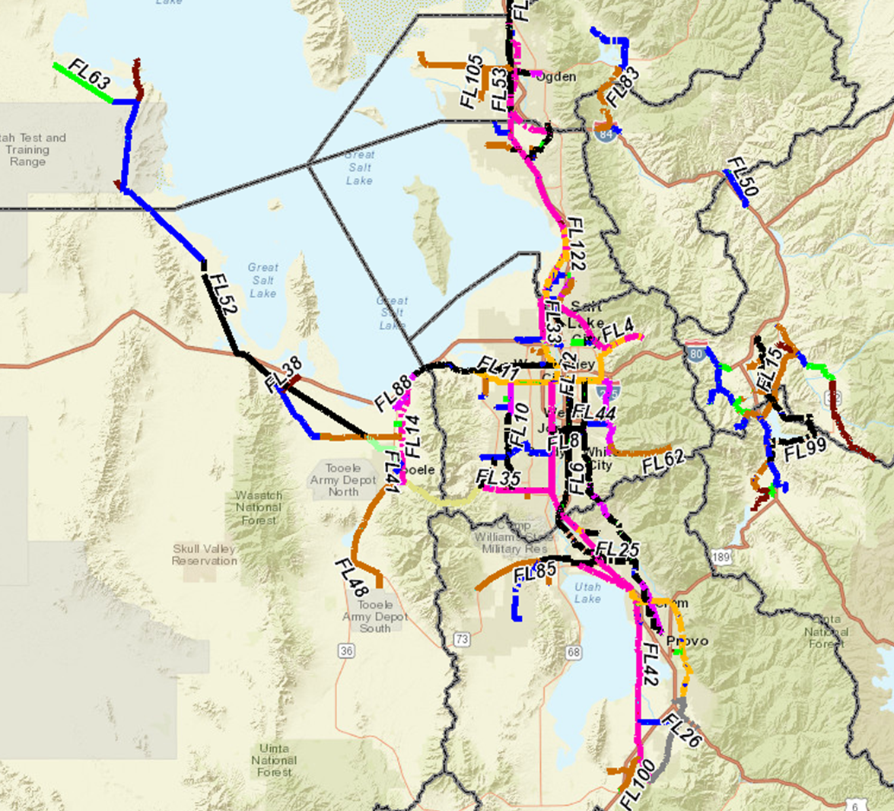
Ogden
296
389
411
West Haven
415
297
430
298
314
293
Alta
316
294
270
Tooele
Draper
326
301
255
Provo
249
Dominion Energy Utah
Docket No. 19-057-13
DEU Exhibit 4.03
Page 3 of 11

Slide 4
Ogden
135
317
330
West Haven
329
126
311
178
138
134
Alta
140
50
126
Tooele
Draper
147
130
37
Provo
18
Dominion Energy Utah
Docket No. 19-057-13
DEU Exhibit 4.03
Page 4 of 11

Slide 5
Ogden
124
291
305
West Haven
303
116
282
177
139
129
Alta
134
30
121
Tooele
Draper
143
127
72
Provo
81
Dominion Energy Utah
Docket No. 19-057-13
DEU Exhibit 4.03
Page 5 of 11

Slide 6
Ogden
86
145
167
West Haven
161
80
102
116
92
80
Alta
103
73
80
Tooele
Draper
117
98
49
Provo
70
Dominion Energy Utah
Docket No. 19-057-13
DEU Exhibit 4.03
Page 6 of 11

Slide 7
Ogden
74
88
122
West Haven
112
65
176
72
* Orange dots indicate that, although the area has lost service, pressures have risen. In this scenario, once an area has lost service, service will not be regained by an increase in pressure.
55
38
Alta
83
95
45
Tooele
Draper
102
81
34
Provo
66
Dominion Energy Utah
Docket No. 19-057-13
DEU Exhibit 4.03
Page 7 of 11

Slide 8
Ogden
69
81
106
West Haven
96
59
157
160
144
82
Alta
76
92
38
Tooele
Draper
97
72
33
Provo
66
Dominion Energy Utah
Docket No. 19-057-13
DEU Exhibit 4.03
Page 8 of 11

Slide 9
Ogden
50
65
41
West Haven
14
30
133
135
116
57
Alta
45
66
27
Tooele
Draper
71
23
44
Provo
84
Dominion Energy Utah
Docket No. 19-057-13
DEU Exhibit 4.03
Page 9 of 11

Slide 10
Ogden
47
62
79
West Haven
83
62
129
131
110
59
Alta
35
59
33
Tooele
Draper
65
59
47
Provo
89
Dominion Energy Utah
Docket No. 19-057-13
DEU Exhibit 4.03
Page 10 of 11

Slide 11
Ogden
62
43
59
West Haven
62
65
122
130
106
73
Alta
12
46
65
Tooele
Draper
51
30
79
Provo
118
Dominion Energy Utah
Docket No. 19-057-13
DEU Exhibit 4.03
Page 11 of 11

