Slide 1
Garkane Energy Cooperative Board, 2023 Wildland Fire Protection Plan Report
Garkane Board Meeting
October 23, 2023
Presented by: Bryant Shakespear

Slide 2
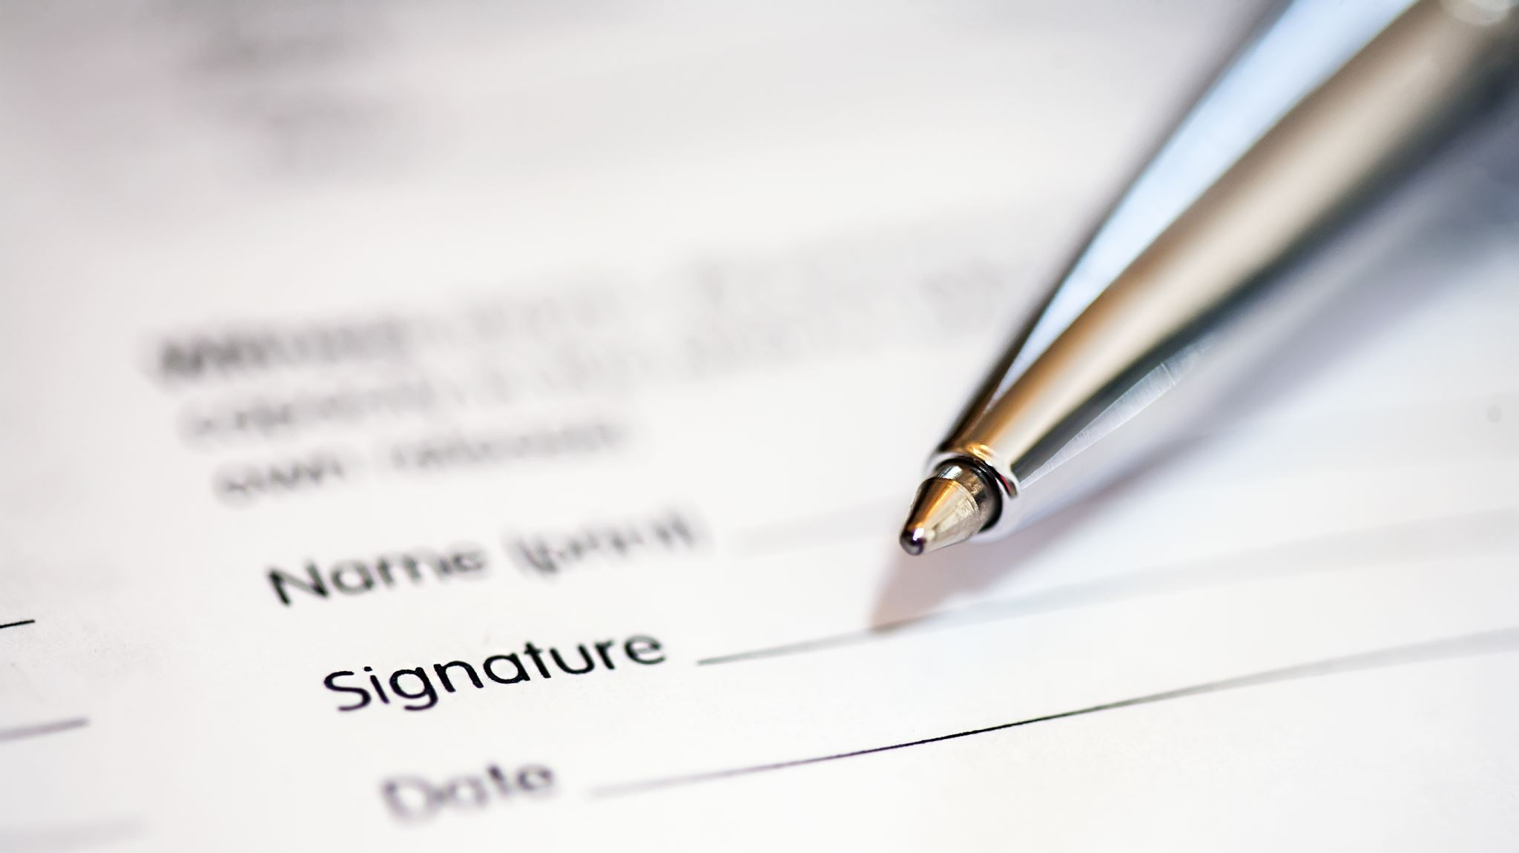
Wildland Fire Protection Plan Requirements
Utah Code § 54-24-203(4) requires electric cooperative to (a) file with the governing authority an annual report detailing the electric cooperative’s compliance with the WFPP; and (b) file with the Commission a copy of the annual compliance report.
Given recent increases in wildfire frequency and severity throughout Utah, on March 28, 2020, the Governor signed House Bill 66, Wildland Fire Planning and Cost Recovery, a law that grants the Public Service Commission rulemaking authority to enact rules establishing procedures for the review and approval of wildland fire protection plans. The law requires qualified utility and electric cooperatives to prepare and submit for approval a wildland fire protection plan in accordance with the requirements outlined in the Bill.
This Wildland Fire Protection Plan (Plan) describes the range of activities that GEC is taking or considering to mitigate the threat of power line–ignited wildfire, including the protocols and procedures that GEC would undertake, as well as industry best practices. The Plan complies with the requirements outlined under House Bill 66 to prepare a wildland fire protection plan by July 1, 2020, and every 3 years thereafter. The final plan has been reviewed by all pertinent agencies, including a third-party review by subject matter experts. The plan was adopted by the GEC Board of Directors on June 1, 2020. All sections of the Plan will be reviewed and revised on an annual basis, and the findings will be presented to the Board of Directors. The Plan will be fully revised every 3 years, which will include a revised risk analysis and development of plan recommendations to incorporate new technology and industry best practices.

Slide 3
Elements of Garkane’s Wildland Fire Protection Plan
Wildfire Risk Analysis
Fire History
Vegetation Communities
Fuels
Topography
Weather
Fire Behavior
Analysis Approach
Wildfire Threat and Wildfire Risk
Objectives
Minimizing Sources of Ignition
Resiliency of the Electric System
Wildfire Prevention Strategies and Protocols
Inspection Procedures
Patrol Inspections
Detailed Inspections
Intrusive Inspections
Vegetation Management Protocol
Modifications and Upgrades to Infrastructure
Reviewed De-Energizing and Re-Energizing Protocols

Slide 4
Wildfire Risk Analysis

Slide 5
Resiliency of the Electric System
Actions Completed to Improve Resiliency of the Electric System
Rebuild of Henryville and Buckskin Substation
Installation of several Trip Saver 2 Reclosers
Updated multiple new reclosers
Tree Trimming by contractor in Orderville, Glendale, Cedar Mtn, Kanab
Maintenance Repairs of Transmission Lines including 138 kv Cottonwood line and 69kv lines in all areas

Slide 6
2023 WFPP Inspection Summary
Total Inspections-9,897
Intrusive-2,454
Detailed-7,443
High Risk Areas 100% Inspected in 2023
Medium Risk 30% Inspected in 2023
Low Risk 22% Inspected in 2023

Slide 7
Minimizing Sources of Ignition
Vegetation Management, Garkane continues to work to get all cycles current. Vegetation Contractor budgeted for 2023 to lead effort to clear right of ways

Slide 8
Engineer Compliance Statement
Based on my review of the reports preparade by my staff it is my opinion that in all material respects Garkane has complied with the terms of the Garkane Energy Cooperative Wildland Fire Protection Plan.
Bryant Shakespear, P.E. 09/22/2023

