Slide 1

Rocky Mountain Power’s
Virtual Update on Cybersecurity
Public Service Commission of Utah
Docket No. 23-999-01
December 8, 2023

Slide 2
Chief Security Office
Operations
Global Security Operations Center
Threat intelligence
Incident Response and Continuity
Architecture and Engineering
Infrastructure and systems design
Policies and standards
Operational technology
Engagement and Assurance
Sector programs
Phishing
Audit and Compliance
Cyber
Physical
Information technology
Government partnerships
Training
Third party risk management
Notes:
Berkshire Hathaway Energy Chief Security Office
Global Focus with Local Management
Intelligence
Enhanced coverage and efficiencies
Phishing at PacifiCorp 0.13% (nearly 300,000 test emails sent this year)

Slide 3
Cyber Hygiene: BitSight
BitSight cybersecurity ratings
  Industry benchmarking
  Similar to consumer credit scores
  Score range: 250-900
Externally available information about internet-facing systems
Leveraged for vendor risk management
PacifiCorp’s score: 800 = “Excellent”

Slide 4
Cyber Security Foundations
Information Security Management System
Systematic approach for managing information security
Vulnerability Management
Inventory
Customized to the context of the organization
Follows the information, not tied to specific systems
Awareness of vulnerabilities
Plan to mitigate and eradicate

Slide 5
Threat-Informed Resilience
1
2
  Classified briefings
  Open source
  Information sharing
Threat Intelligence
Modeling
and Analysis
  Identify points of failure
  or system weaknesses
  Independent identification
Drills and Exercises
Resilience Action Plans
4
3
  After-action gap tracking
  Third-party expertise
  Focus on failure scenarios
  Standards or policies
  Technologies
  Engineering or design
5
Notes:
Ballistic Protection Enhancement
Operational Technology Detection
Supply Chain Assessments
NERC GridEx
DOE Liberty Eclipse
Military engagements

Slide 6
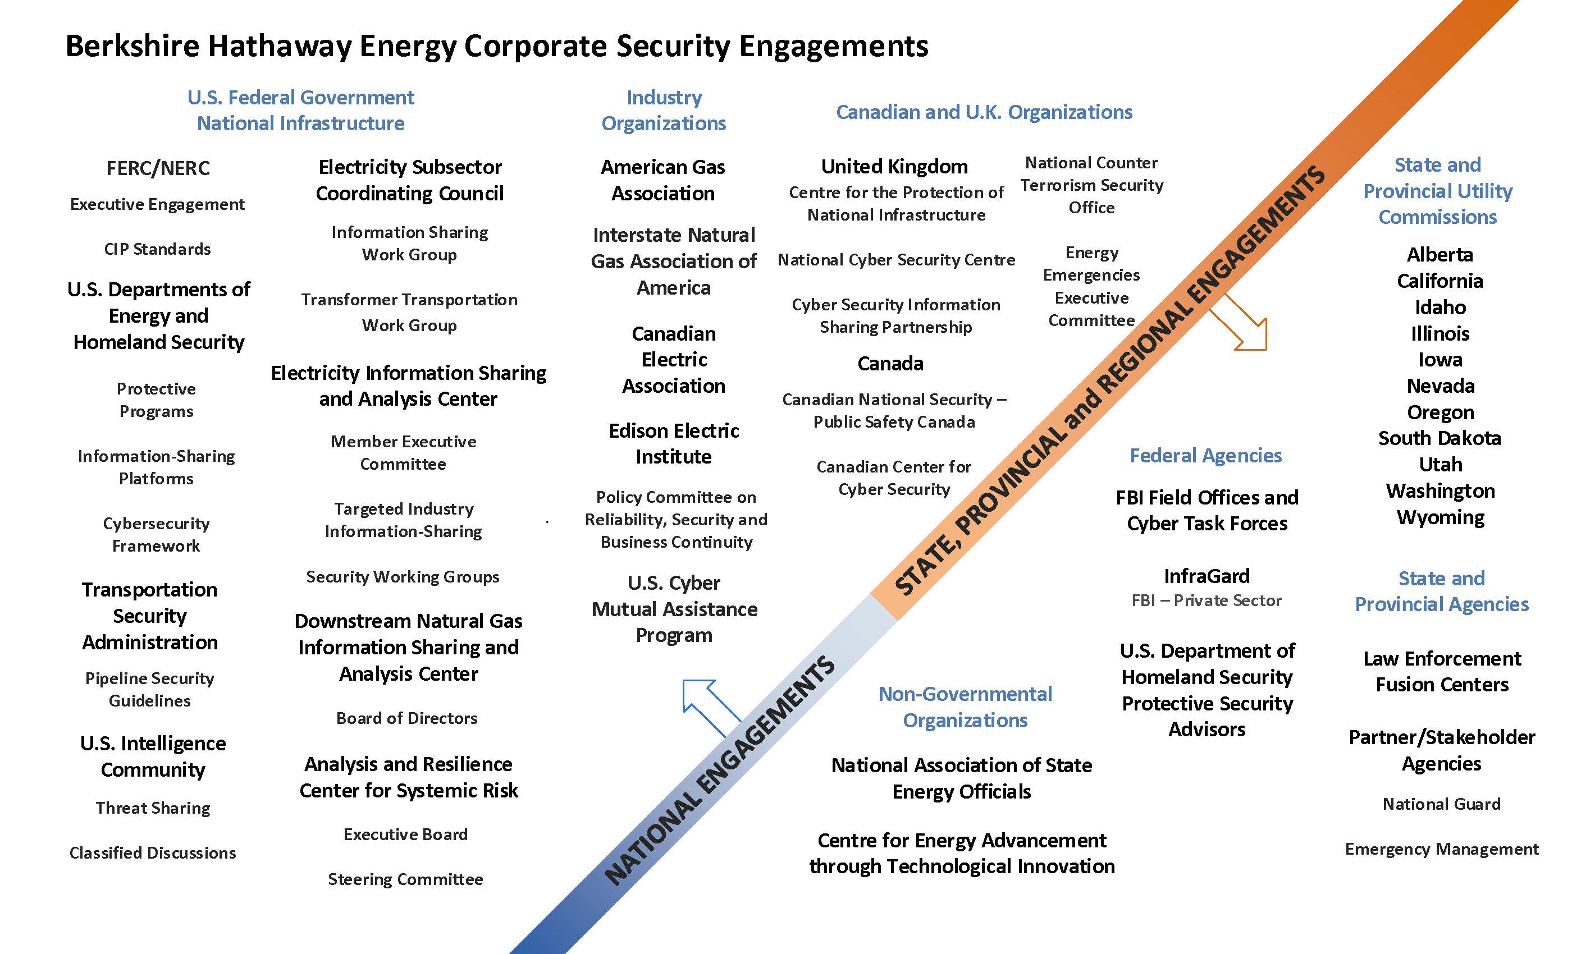
External Engagements

Slide 7
Thank you

