Slide 1
DPU - Pipeline Safety
2026 Briefing
Thursday March 19, 2026
Jimmy Betham – UTPS Program Manager

Slide 2
Utah Pipeline Safety
Mission
The mission of the Utah Pipeline Safety (UTPS) is to ensure the safe construction, operation, and maintenance of intrastate natural gas pipelines in the state of Utah. This is accomplished through education, inspection, enforcement, and investigation of incidents/ accidents. Our ultimate responsibility is protecting the public and the environment from the potential dangers of natural gas in transportation.
Vision
Utah aligns with the national vision of "Zero Incidents," often echoed by its federal partner, the Pipeline and Hazardous Materials Safety Administration (PHMSA), which seeks to protect people and the environment by advancing the safe transportation of natural gas.
Goals
The state’s specific safety goals focus on accountability and risk reduction:
Establish Standards: Set and enforce minimum safety standards for operators.
Risk Management: Ensure operators identify, manage, and mitigate risks associated with their infrastructure.
Public Awareness: Partner with organizations like Blue Stakes of Utah to educate excavators and the public on "Call Before You Dig" laws to prevent third-party damage.
Continuous Improvement: Encourage operators to build a strong safety culture that goes beyond minimum regulatory compliance.

Slide 3
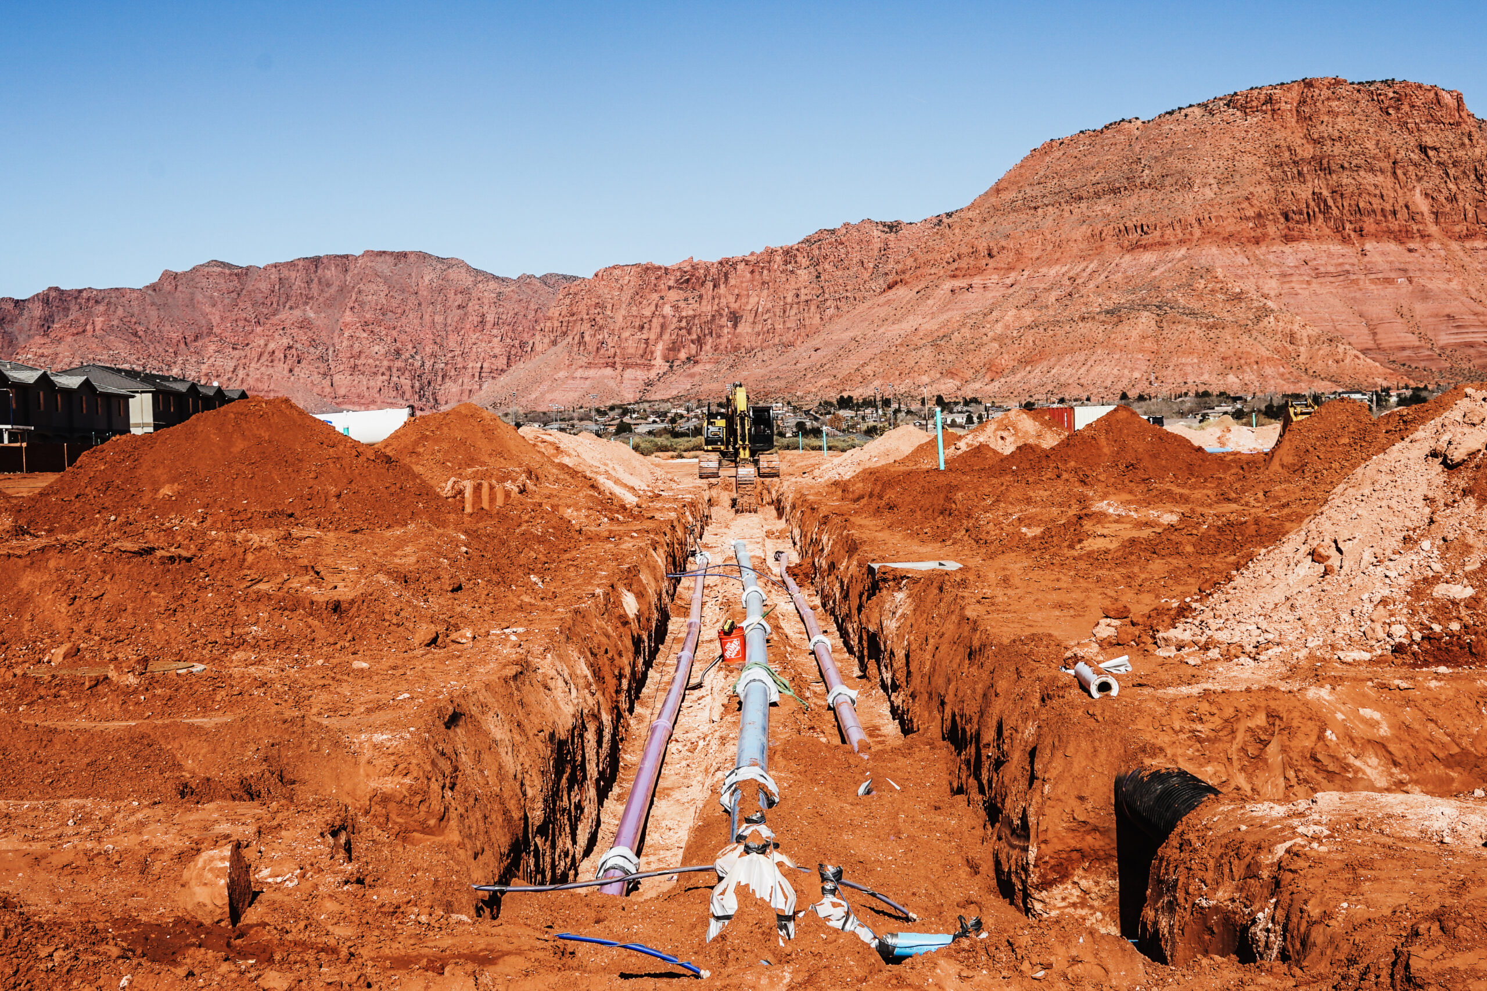



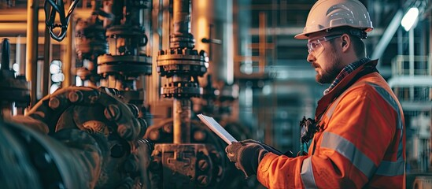


Utah Code Title 54
Public Utilities Statutes and Public Service Commission Rules
Chapter 8a – “Damage to Underground Utility Facilities”
Chapter 13 – “Natural Gas Pipeline Safety”

Slide 4
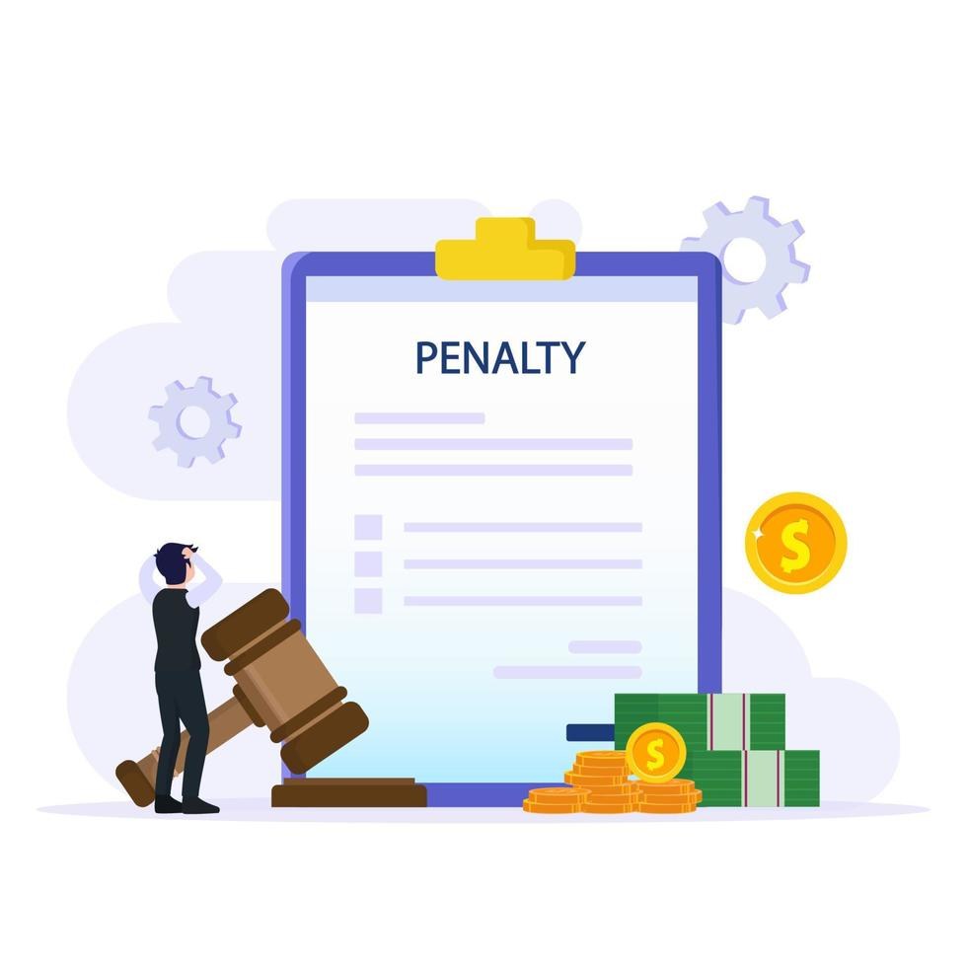
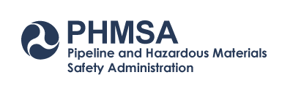
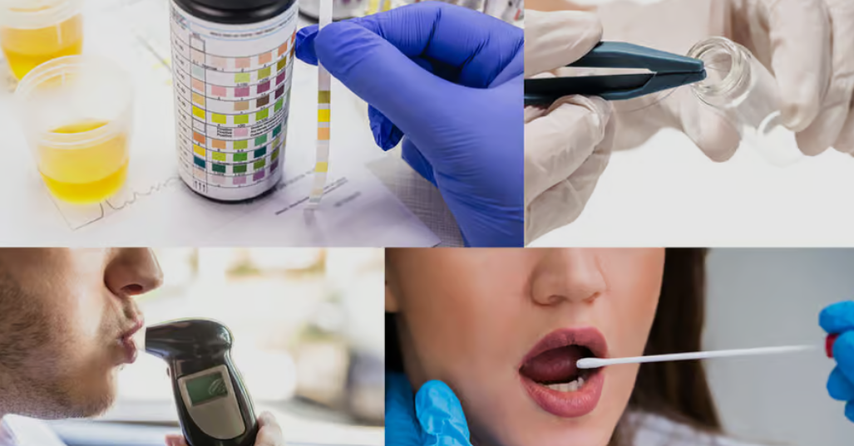

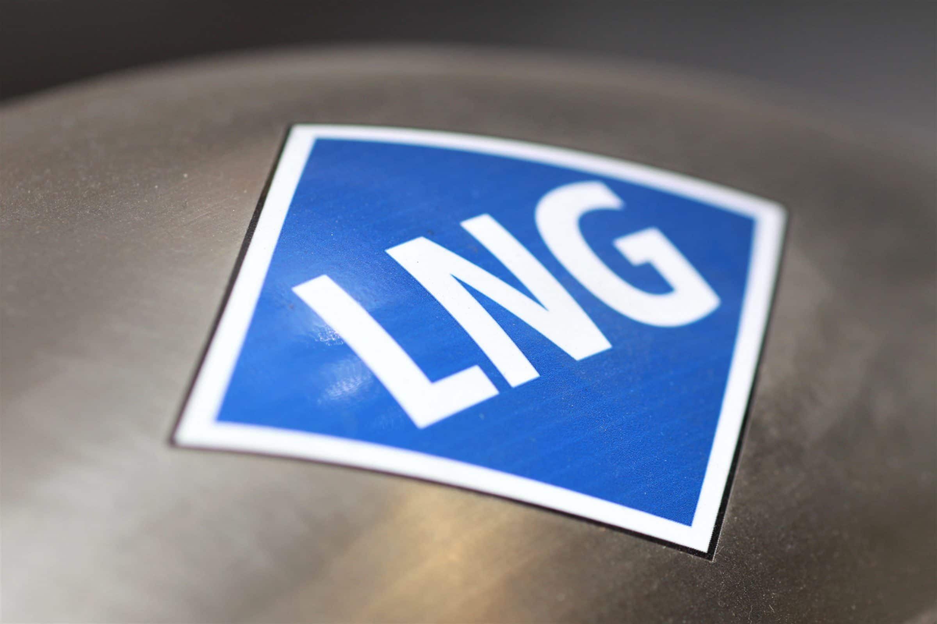

Utah Code Title 54
Public Utilities Statutes and Public Service Commission Rules
R746-409-1(B) Adoption of parts of CFR Title 49 - Pipeline Safety
  Part 190 with the exclusion of Part 190.223 (Penalty amounts)
  Part 191 – Annual, Incident and Safety Related Reports;
  Part 192 – Minimum Pipeline Safety Standards;
  Part 193 – Liquified Natural Gas Safety Standards;
  Part 198 – State Grants; and
  Part 199 – Drug Testing.

Slide 5
PHMSA has Exclusive Federal authority for all pipeline facilities
  PHMSA makes pipeline safety regulations
  It provides training and qualification and grant
  money under a certificate to state programs
  Duration of this certificate is from Jan. 1st to Dec. 31st
  Utah’s certificate is for gas only
  60% of UTPS’s funding is provided by the grant
  Certificate requires a set of performance standards for state programs that must be met

Slide 6
Notes:
Jimmy – update with 2024 numbers.

Slide 7
PHMSA evaluation of UTPS performance
- Progress report
- Field audit
 | 2020 | 2021 | 2022 | 2023 | 2024 | 2025
Progress Report | 50/50 | 50/50 | 50/50 | 50/50 | 50/50 | 50/50
Field Audit | 97/100 | 97/100 | 100/100 | 100/100 | 100/100 | 100/100

Slide 8
Yearly progress report to PHMSA
1. Stats on operators/inspection units and % inspected
2. State inspection activity data
3. List of regulated operators
4. Incidents/accidents data
5. Stats of compliance actions data
6. List of different types of records kept
7. Staff and T&Q training data
8. Adoption status of federal regulations
9. Performance and damage prevention question data

Slide 9
PHMSA field audit
A – Progress report and program records review
B – Program inspection procedures
C – Records of inspector qualification
D – Program performance
E – Field inspection
F – Damage prevention

Slide 10
Regulated Pipeline Operator Types
  Local Distribution Company (LDC) 1
  Liquid Natural Gas (LNG) 1
  Intrastate Transmission 8
  Municipalities 5
  LPG operator 2
  Gas Gathering 14
  Master Meter operators 48
    Total regulated operators 79
    as of 12/31/2025

Slide 11
Regulated Intrastate Pipelines
Intrastate Gas:
  Transmission mileage: 837.412 Miles
  HCA : 177.132 Miles
  Distribution mileage: 21,143.1 Miles (80.95% PE mains)
  Total Number of services: 1,050,493 (5435 on Municipal)
  Gas Gathering pipeline miles:
                Type A: 13.312
                Type B: 4.414
                Type C: 945.853
                Type R: 5144.103
2025 Annual Reports
Common Ground Alliance and DIRT Tool
Notes:
Jimmy – see Al’s annual reports data spreadsheet – he has 2024 numbers

Slide 12
Utah Damage Prevention Stats 2025
Total # of Blue Stakes Tickets: 462,231
Number of Pipeline Damages: 1,167
Damages per thousand tickets: 2.52
Notes:
As part of the Distribution annual reports ……. operators are required to report these stats.
These are the totals for all regulated operators in Utah.
During 2025 there were 590,701 locate tickets called in to Blue Stakes of Utah.
There were total of 1383 damages.
And our damages per thousand tickets was 2.34,
Damages per thousand is a metrics used by the industry and PHMSA.

Slide 13
Notes:
Of the total of 1167 damages
44% was caused by excavation error,
29% was due to excavating without a locate ticket, and
26% was caused by operator error.

Slide 14
Notes:
See Al’s spreadsheet for 2024 numbers

Slide 15
Post Locate Inspections
Most Common Threats Identified:
Locator Performance
  Demand exceeding staff capability
  Contract versus in-house
  Statutory nuisances (ticket size, timing, project tickets)
  Unlocatable facilities
Fiber (Telecom)
  Compliance
No One-Call Ticket
  Professional excavators

Slide 16
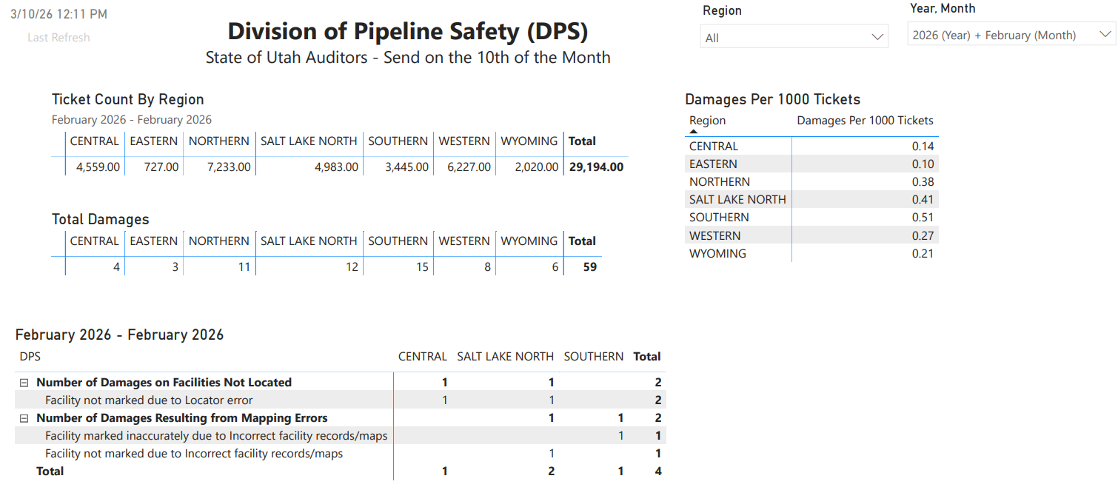
Bringing Program Concept to All States
  LDCs, Municipalities, Co-ops
State Responsibility
  PHMSA to assist (clear the path)
Category | 2023 YTD | 2024 YTD | % Change
Number of Late Locates | 75,321 | 25,656 | 65.9% ↓
% On-Time Locates | 70.60% | 89.20% | 26.3% ↑
Number of No-Shows | 12,522 | 3,102 | 75.2% ↓
Number of No-Show Damages | 89 | 17 | 80.9% ↓
Total Gas Damages | 828 | 619 | 25.2% ↓
Third-Party Damages | 458 | 408 | 10.9% ↓

Slide 18
UTPS inspection Process and Results
&
Demonstration of
PHMSA’s Inspector Assistant (IA) software

Slide 19
Inspection Types
The type of inspection is based on UTPS’ 3-5 Year Inspection Cycle:
    Standard inspections every year
    Operation and Maintenance Plan 3 years
    Emergency Plan 3 years
    LNG 3 years
    Anti-Drug and Alcohol Plan 5 years
    Public Awareness Plan 5 years
    Operator Qualification Plan 5 years
    Integrity Management
    Programs & Methane Emissions 5 years
    9. Control Room Management Plan 5 years
    10. Master Meter 5 years

Slide 20
Review of Records and Procedures
Inspection of Operational Plans and records include all aspects of the operation and maintenance of pipelines and components
At a minimum must include but are not limited to; leak surveys, patrolling, corrosion control, odorization, valves, MAOP, regulator stations, relief devices, vaults, TIMP, DIMP, ILI, SRCs, OQ, PAPE, construction, incidents, odor complaints and farm taps, if applicable.
Inspections are conducted using the PHMSA IA software program.

Slide 21
Field inspections
The Field inspection includes an on-site inspection of the operator's facilities to confirm that system maintenance is being performed as prescribed by the plans/procedures and indicated by the operator’s records.
UTPS physically conducts an on-site inspection of existing system facilities, such as but not limited to, regulating stations, odorizers, commercial and industrial meters and regulators, relief devices and vents, exposed mains & transmission pipes, valves, rectifiers, CP Test Stations, CP Bonds, compressor stations, etc.

Slide 22
Inspection length
LDC – 10 inspection Units: 6-days per unit (Region)
Municipalities, gathering and intrastate transmission –
1 inspection unit each: 3-5 days
Master meter: ½-1 day
Construction inspections are a daily inspection and large construction sites may be inspected on multiple days or multiple times throughout the project
Incidents investigations vary per incident

Slide 23
2024 & 2025 Inspection activities/results | 2024 | 2025
Number of Inspections | 51 | 56
NOPV letters Issued | 21 | 17
Numbers of violations found | 87 | 32
Probable violations from previous year | 94 | 64
Numbers corrected | 117 | 85
Carry over to next year | 64 | 11
Construction | 48 | 74
Incident | 22 | 19
Notes:
The numbers shown for 2024 are accurate as of 12/31/24. The numbers presented in the 2024 PSC presentation were accurate as of 12/10/24, the date of the presentation.
The numbers shown for 2024 in the PSC presentation given on 12/10/24 showed the numbers that were accurate as of 12/10/24. Those numbers were:
Numbers of violations found: 84
Probable violations from previous year: 94
Numbers corrected: 88
Carry over to next year: 90
Construction: 38

Slide 24
Gas Gathering New Regulations and Pipeline Types

Slide 25
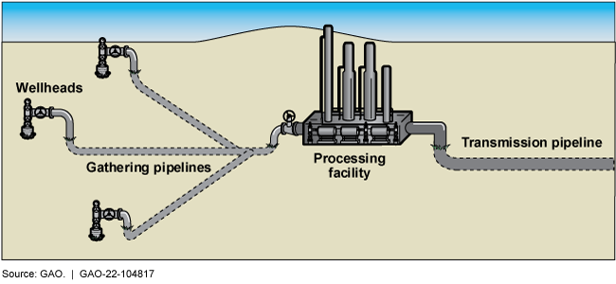
Gas Gathering Pipelines

Slide 26
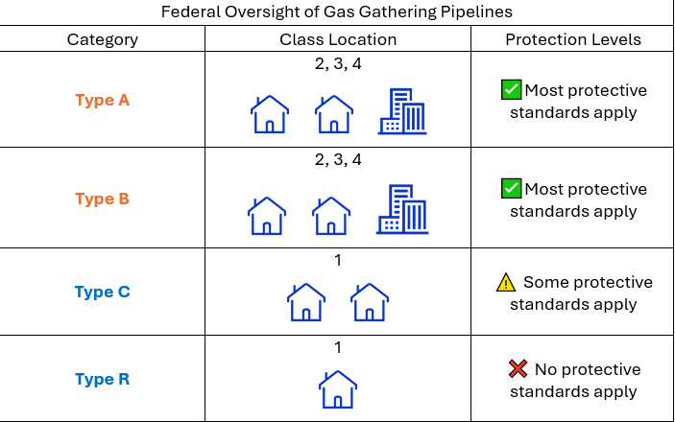
What is Gas Gathering?
Transportation of gas from a production field (oil & gas wells) to a transmission line for further processing
  Four categories of Gas Gathering
    Type A (Pressure >20% SMYS, Class 2, 3 or 4 area**)
    Type B (Pressure >20% SMYS, Class 2, 3, or 4 area**)
    Type C (Newly Regulated in 2022; Class 1 areas*, > 20% SMYS)
    Type R (Newly Regulated in 2022: Class 1*, Reporting requirements only)
  Type A and B Gas Gathering has been regulated by UTPS since 2006
*Class 1 Area = 10 or fewer buildings in PIR (Potential Impact Radius)
**Class 2, 3, 4 = (10-46 buildings), (46+ buildings), and (buildings with 4+ stories)

Slide 27
What is Required?
  Requirements vary based on Operating Pressure, Diameter, and Class Location (how many buildings are nearby)
    Type A lines: required to follow most high-pressure Transmission regulations
    Type B lines: requirements listed in § 192.9(d)
      Construction/initial testing
      Corrosion Control & Plastic Damage Prevention
      Leak Surveys
    Type C requirements vary by diameter of pipe and no nearby buildings exemption
    Type R – Incident Reporting, Operator ID Registration

Slide 28
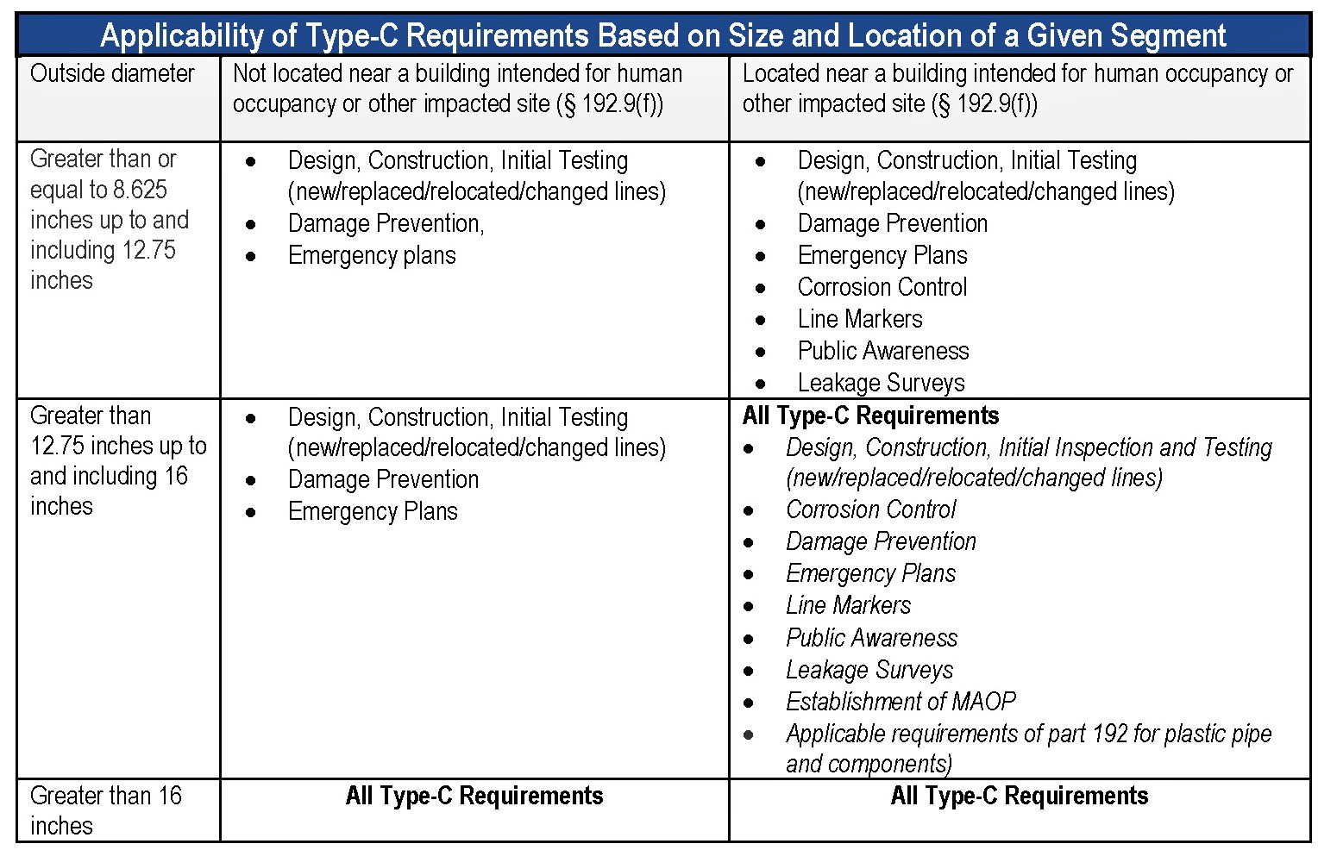
2021 Gas Gathering Rule
Rule issued in response to proximity of neighborhoods/developments near high pressure, large diameter gathering pipelines across the US
Newly regulated operators in Utah due to new categories: 10+ (more expected)
  Gathering Type C: Often leaving compressor stations transporting high pressure gas to a gas processing facility
        Diameter > 8”
        Class 1*
        SMYS > 20% (or > 125psig if non-metallic)
  Gathering Type R: Often plastic, aboveground, < 75psig, lots of mileage connecting wells to compressor stations/separators
        Diameter < 8”
        Class 1*
        Any pressure
Total of over 6,000 miles of newly regulated gas gathering pipelines in Utah
*Class 1 Area = 10 or fewer buildings in PIR (Potential Impact Radius)

Slide 29
Questions

